Slide 1
TRANSMISSION IMPAIRMENT
CSE320 – Data Communications
Department of Computer Science and Engineering School of Data & Science

Slide 2
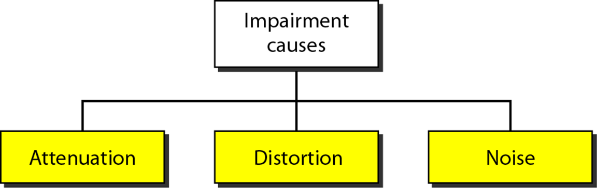
TRANSMISSION IMPAIRMENT
Signals travel through transmission media, which are not perfect. The imperfection causes signal impairment.

Slide 3
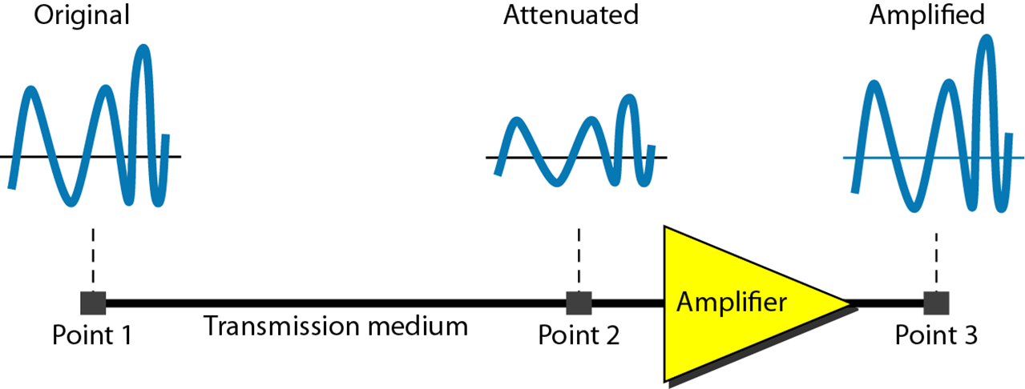
Attenuation
Loss of energy

Slide 4

Example
Suppose a signal travels through a transmission medium and its power is reduced to one-half. This means that P₂ is (1/2)P₁. In this case, the attenuation (loss of power) can be calculated as
A loss of 3 dB (–3 dB) is equivalent to losing one-half the power.

Slide 5
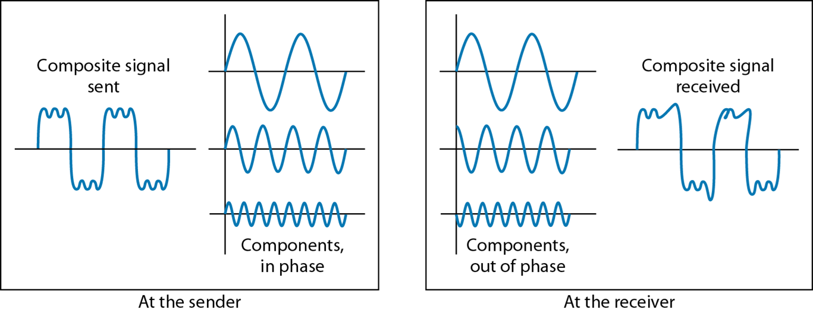
Distortion
changes in the form or shape of the signal

Slide 6
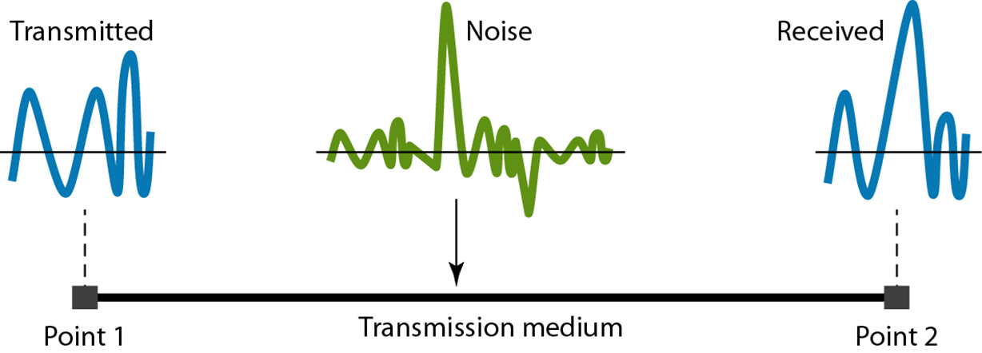
Noise
unwanted signal that mixes up with the original signal

Slide 7
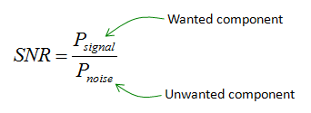
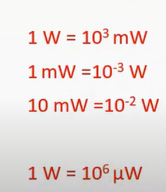
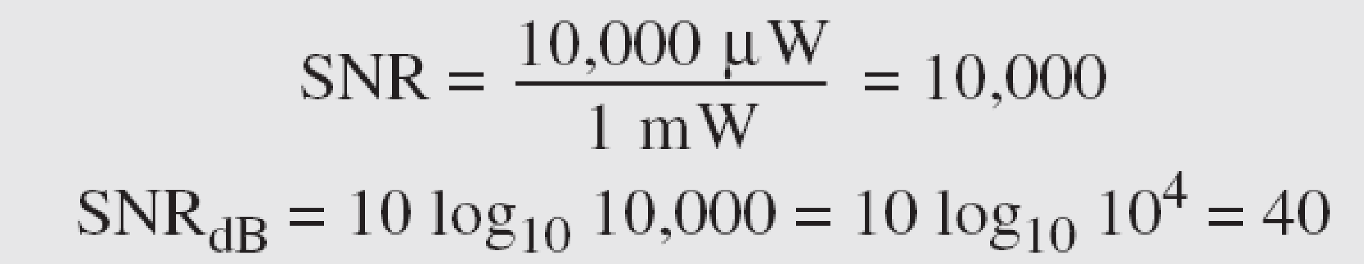
Signal to Noise Ratio (SNR)
Example: The power of a signal is 10 mW and the power of the noise is 1 μW; what are the values of SNR and SNR_{dB} ?
Solution
The values of SNR and SNR_{dB} can be calculated as follows:

